Slide 1
ISI Presentation
Douglas Li
Tim Xin
Rancho Zhou
Price Ou
Jack Yang

Slide 2
Introduction
This project aims at providing an elegant online shopping experience to tentative customers. The system contains one vendor and multiple potential customers. And the interaction between the two parties can be stated as follows. The vendor displays the products in a manner which is easy for customers to select, place orders, and make purchases. Our online shopping mall provide a platform for sneaker trade. The interaction between vendors and customers can be stated as follows. The vendor provides descriptions and images of their selling sneakers. This website will display that information in a list for customer. Customer can select product items, place orders and make purchases.

Slide 3
Object For customer
The front page of the shopping mall shows a product list A
The product detail page shows detail information about one product A
The system has basic account management for customers B
To make any purchase, a customer must add products to his/her shopping cart. The customer can check out all items in the cart to place an order C
After placing an order, the customer can trace the processing status of the order in a purchase tracking page D

Slide 4
Object For Vendor
The vendor can browse the product catalog, edit some properties of a product, and add new products E
The vendor can list purchase orders by different status. He/she may ship, hold, or cancel a purchase order in the purchase order processing page F

Slide 5
Object Advantage Function
The vendor can analyze the sales of the products and find out the best selling products. Z1
Design a notification feature to make it to easier for a customer to track the change of status of purchase orders Z2
Customers can rate for products in the shopping mall Z3
Customers also want to write short reviews for products in the shopping mall Z4
Vendor can maintain price change of product Z5

Slide 6


Background and Related Work General Feature
Sign (Log in, Log out, Sign up)
Shopping Cart
Payment Options
Check out
Consumer Feedback
Goods Return
Customer Support
Website Security

Slide 7
Background and Related Work General Feature
For customer
Customers can give comments and star rating if they want.
All comments can be seen by all customers.
For vendor
Provide a tool to help vendor analyze the sales of products.

Slide 8
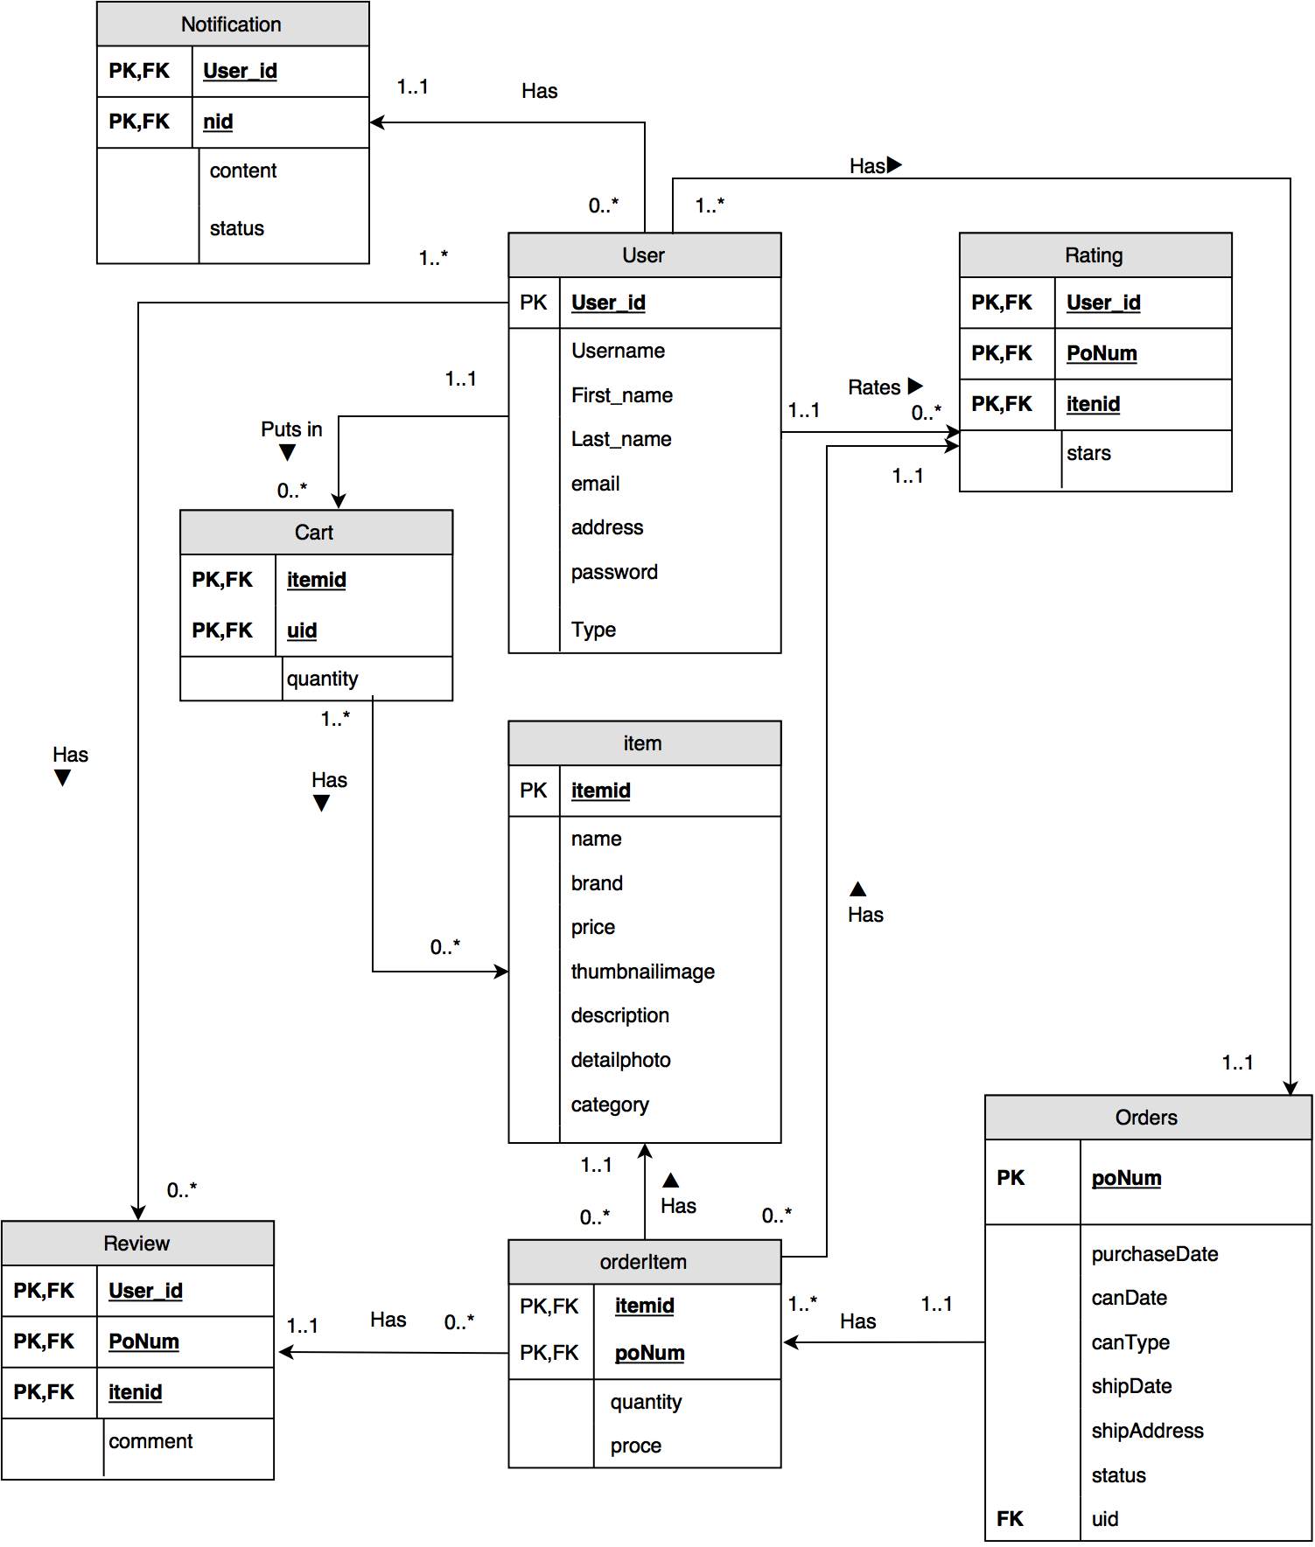
System Design Data Modeling
Entity-Relationship Diagram
It includes eight tables:
Cart
User
Rating
Item
orderItem
Orders
Review
Notification

Slide 9
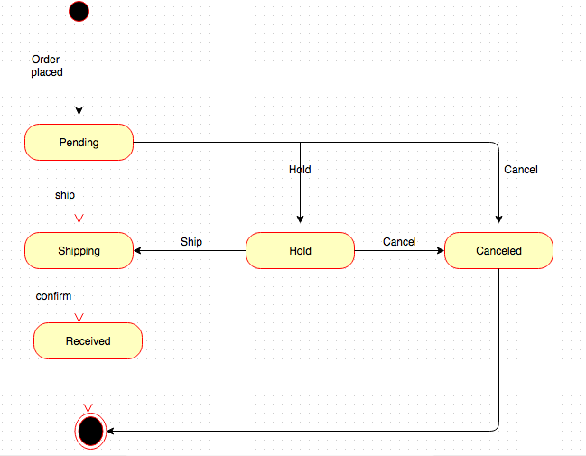
System Design Dynamic Modeling

Slide 10
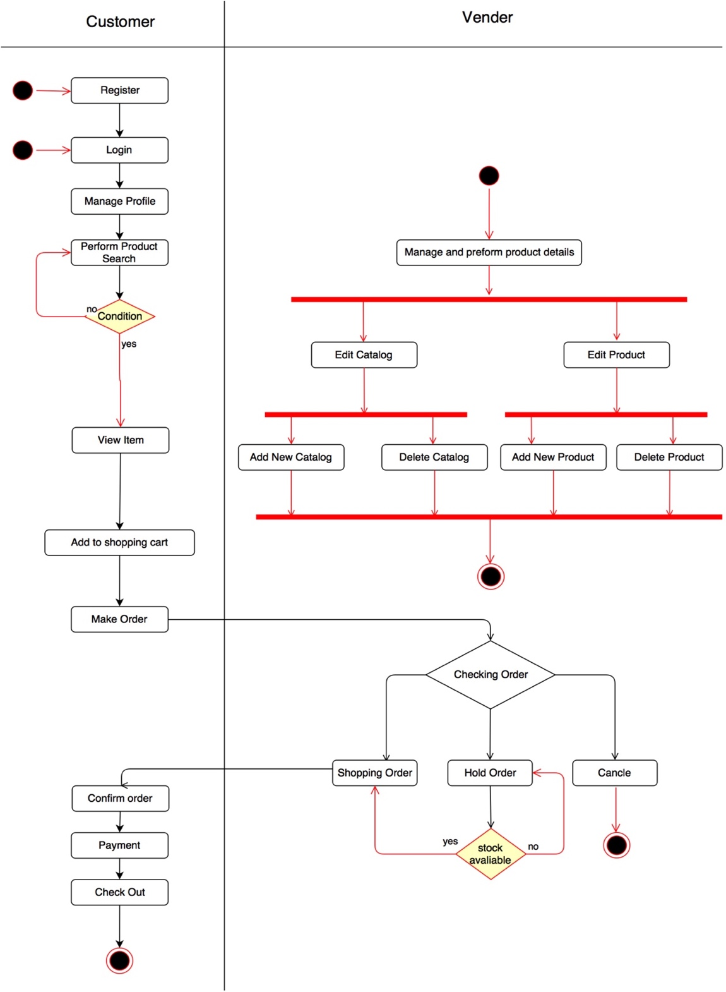
System Design Purchase Activity Diagram
The purchase activity performs the function of illustrating all the possible customer behaviors when they enter the website homepage. Furthermore, it meanwhile shows the possible operations when user enters by vendor.

Slide 11



System Implementation Platforms
Focusing on the programing language at the back-end, we use C# as the back ground language
Focusing on the programing language at the front-end, we use HTML5, CSS3, and JavaScript
Focusing on the framework of background, we use .NET framework
Focusing on the database, we use MySQL
Focusing on revision control, we use GitHub

Slide 12
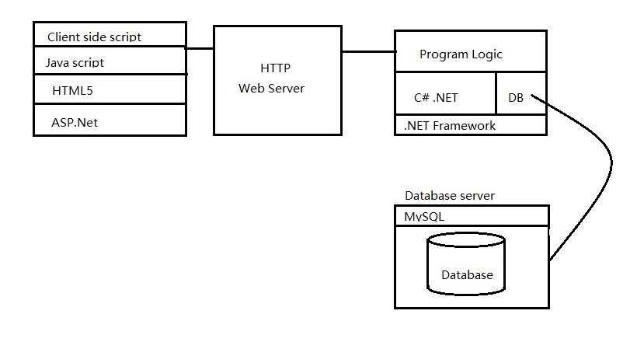
System Implementation Architecture

Slide 13
System Implementation Module Design
Account
Brand
Product
Shopping cart
Order
Vendor operation

Slide 14
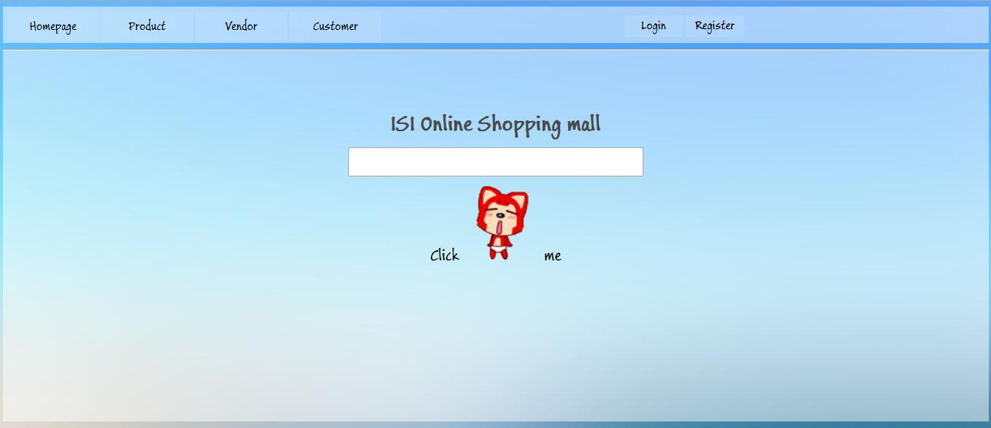
System Implementation Project Outcome Home Page

Slide 15
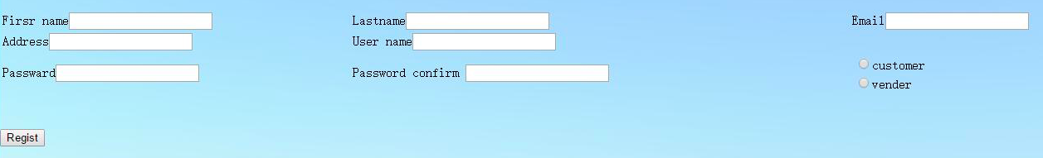
System Implementation Project Outcome Register and Log in

Slide 16
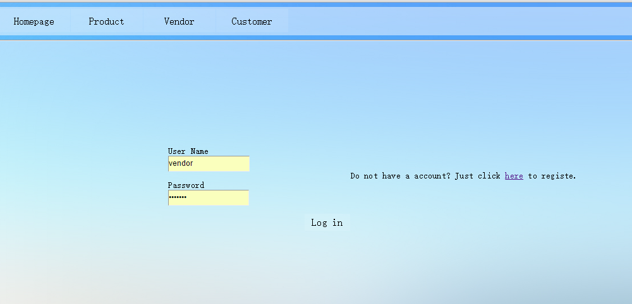
System Implementation Project Outcome Register and Log in

Slide 17
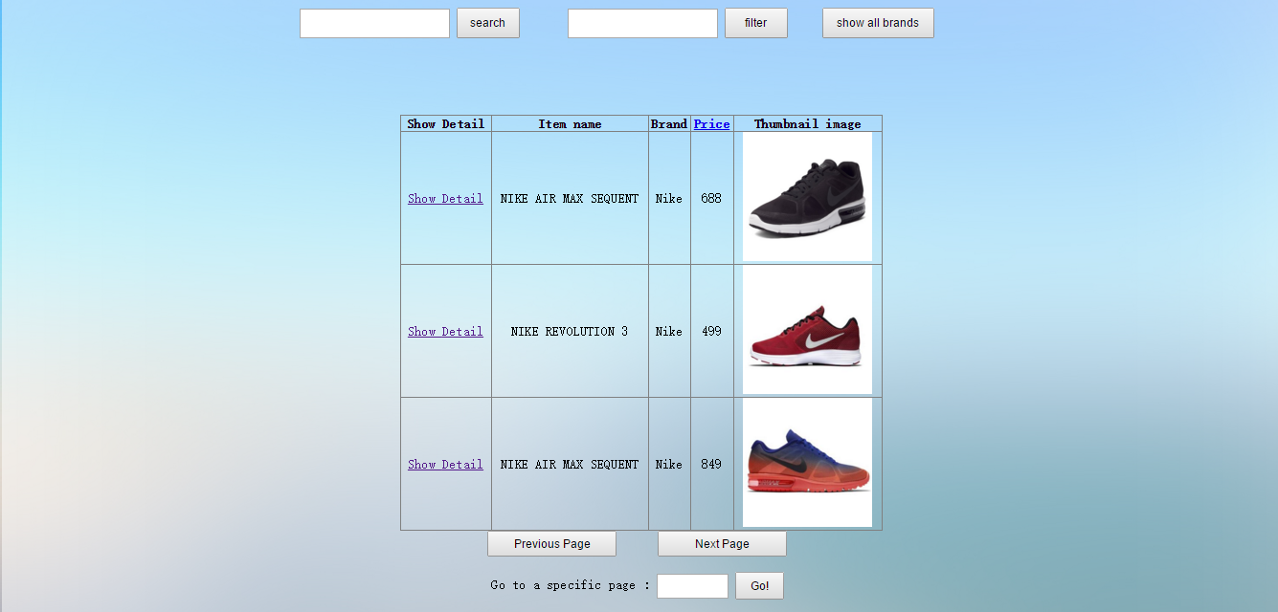
System Implementation Project Outcome Purchasing Product

Slide 18
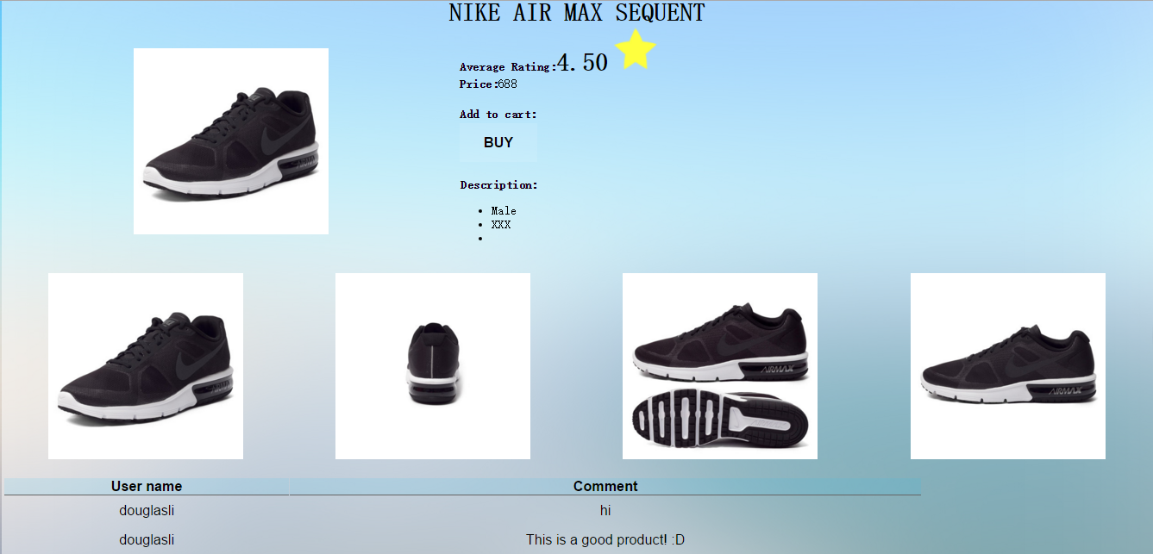
System Implementation Project Outcome Purchasing Product

Slide 19
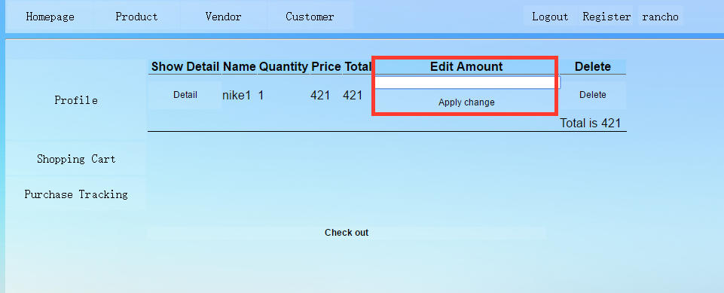
System Implementation Project Outcome Purchasing Product

Slide 20
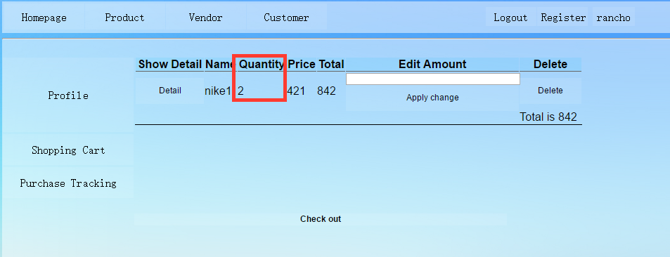
System Implementation Project Outcome Purchasing Product

Slide 21
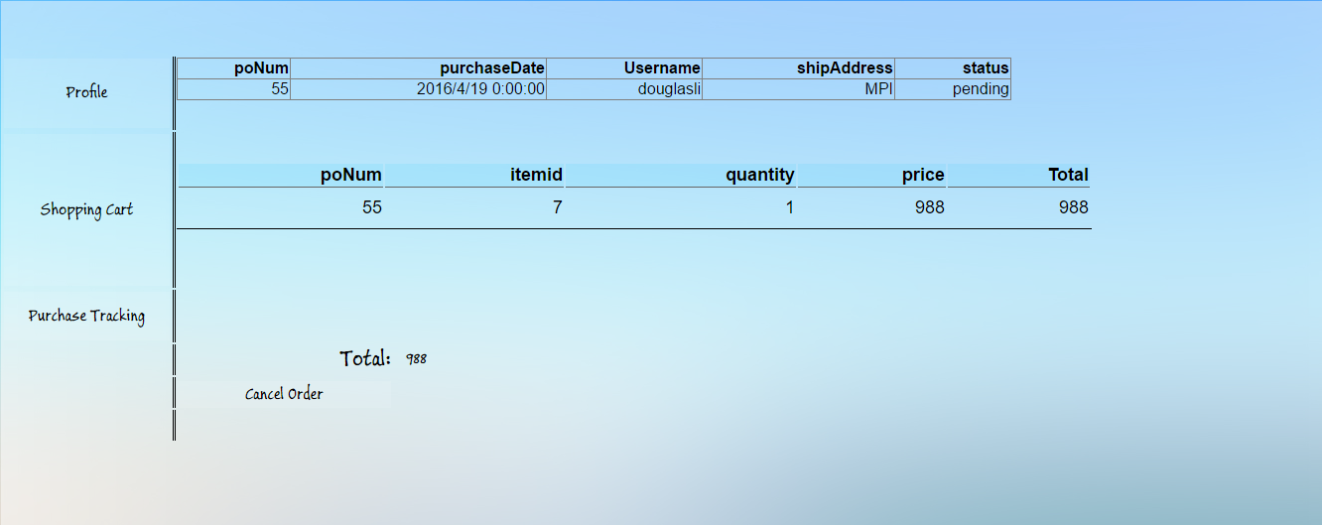
System Implementation Project Outcome Purchasing Product

Slide 22
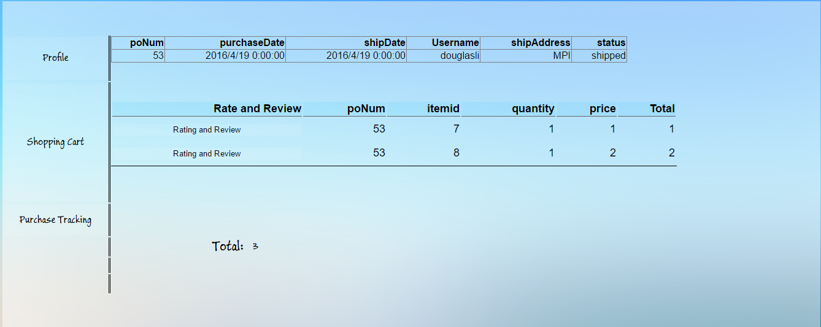
System Implementation Project Outcome Purchasing Product

Slide 23
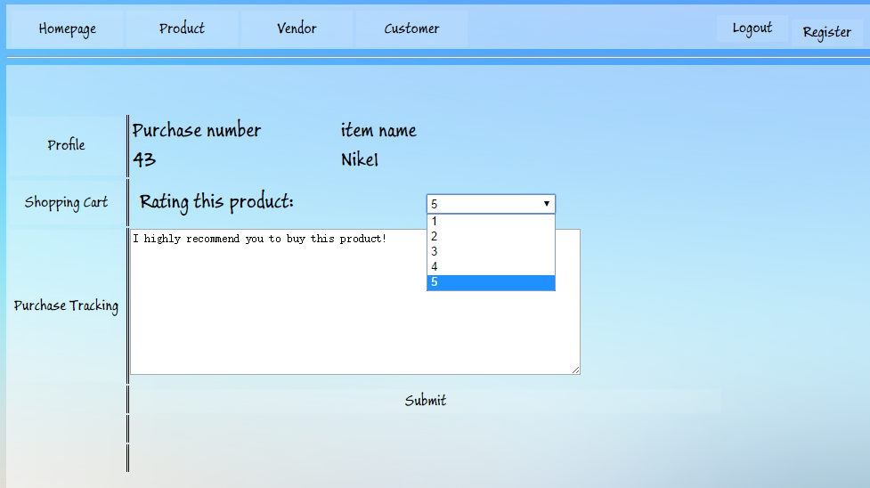
System Implementation Project Outcome Purchasing Product

Slide 24
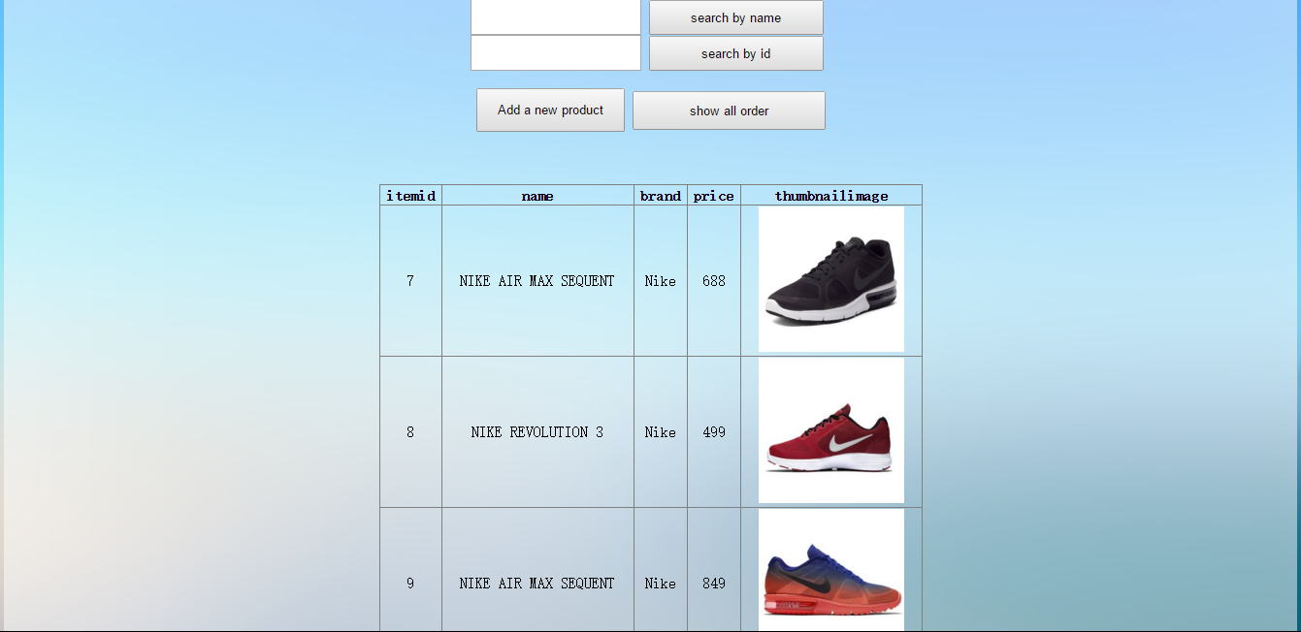
System Implementation Project Outcome Vendor Page

Slide 25
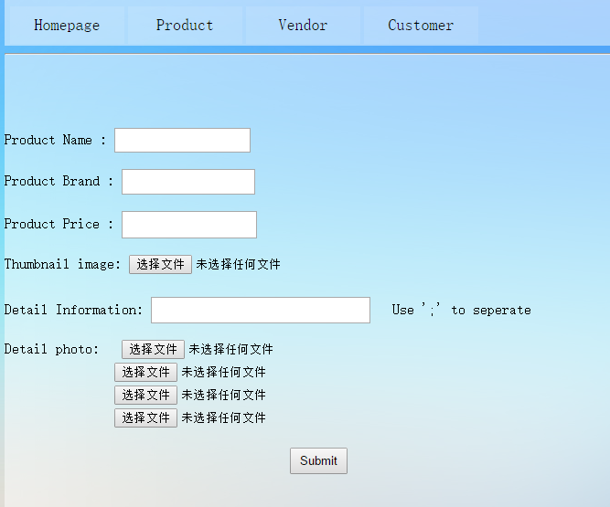
System Implementation Project Outcome Vendor Page

Slide 26
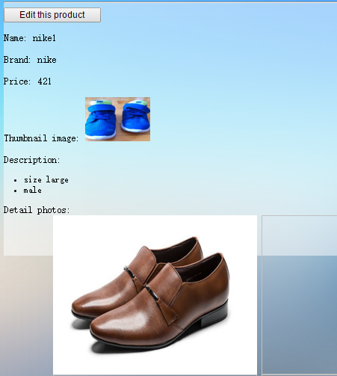
System Implementation Project Outcome Vendor Page

Slide 27
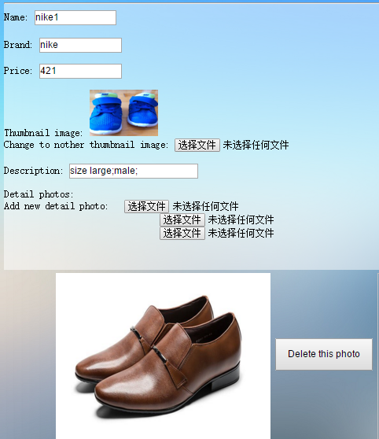
System Implementation Project Outcome Vendor Page

Slide 28
System Implementation Project Outcome Vendor Page

Slide 29
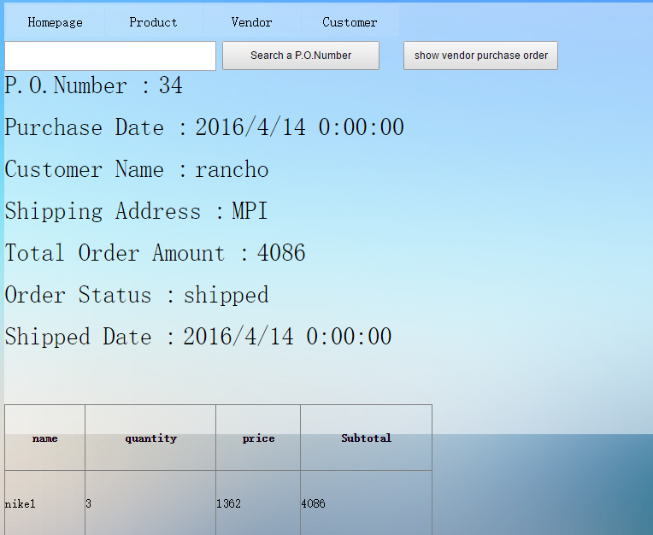
System Implementation Project Outcome Vendor Page

Slide 30
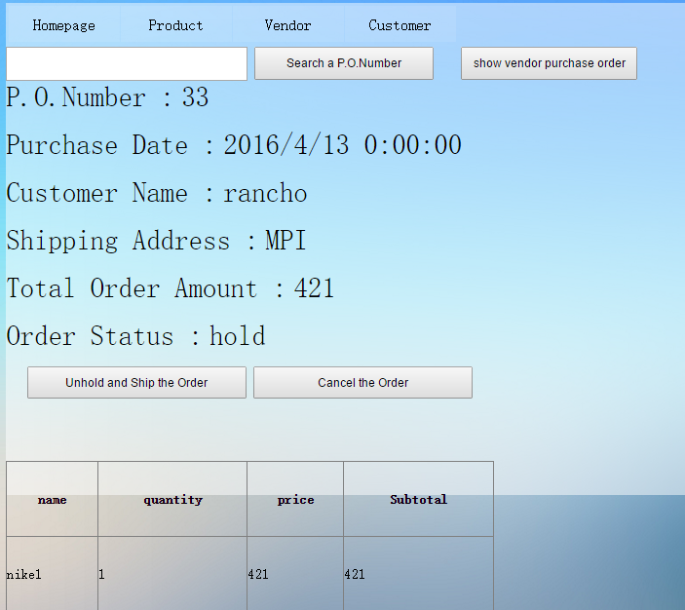
System Implementation Project Outcome Vendor Page

Slide 31
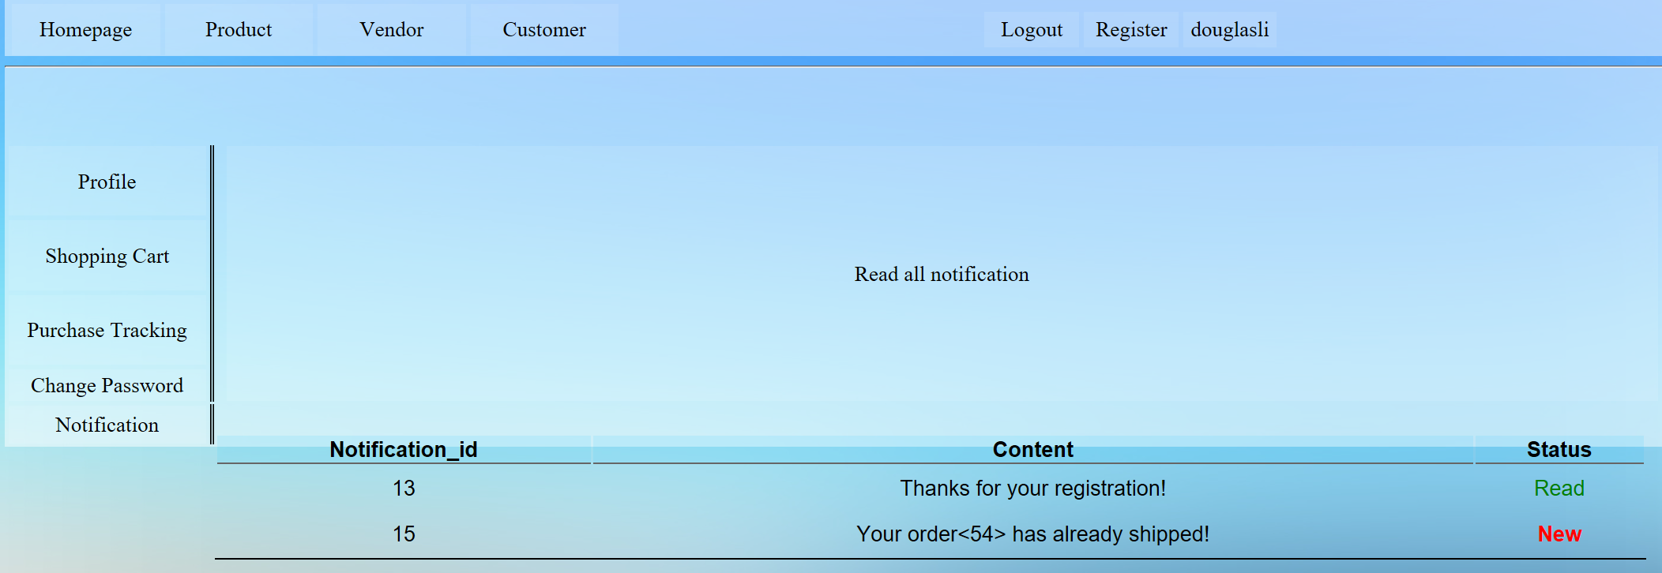
System Implementation Project Outcome Notification

Slide 32
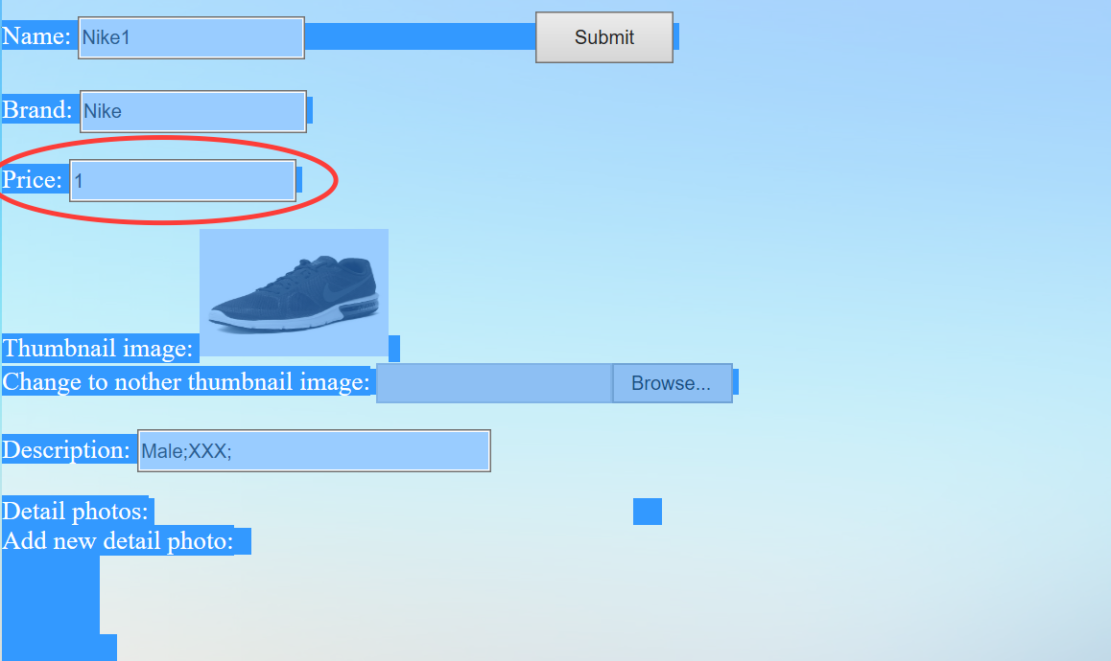
System Implementation Project Outcome Change Price

Slide 33
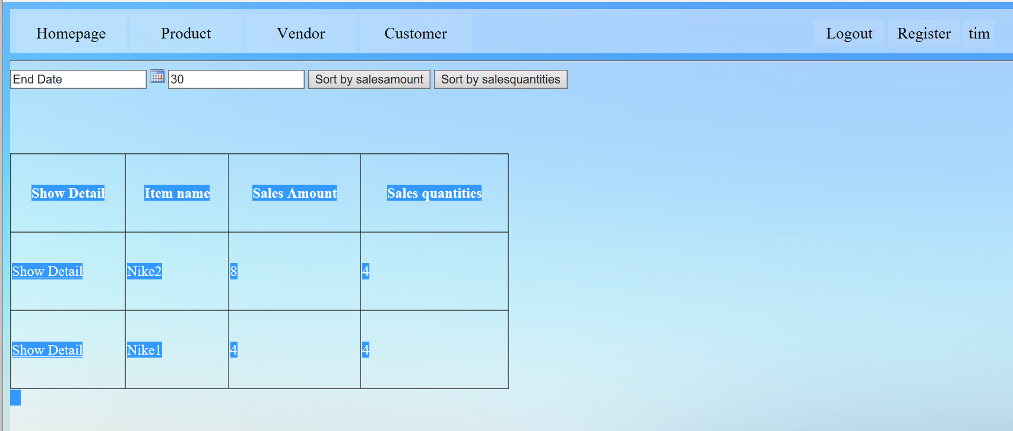
System Implementation Project Outcome Report Page

Slide 34
System Implementation Testing
Browse products and paging
Filter or search product and sort product
Show product detail
Duplicate user name
Access deny for anonymous user
The password is not in requirement form
Missing some required information when registration
Wrong information in user login
Shopping cart

Slide 35
System Implementation Testing
Customer adds a duplicate product
Purchase order
Cancel purchase order
Vendor can search product
Missing information when add new product
Edit information of product
Vendor browses purchase order
Vendor change purchase statues

Slide 36
System Implementation Testing
Analyze report
Notification
Rating
Price change

Slide 37
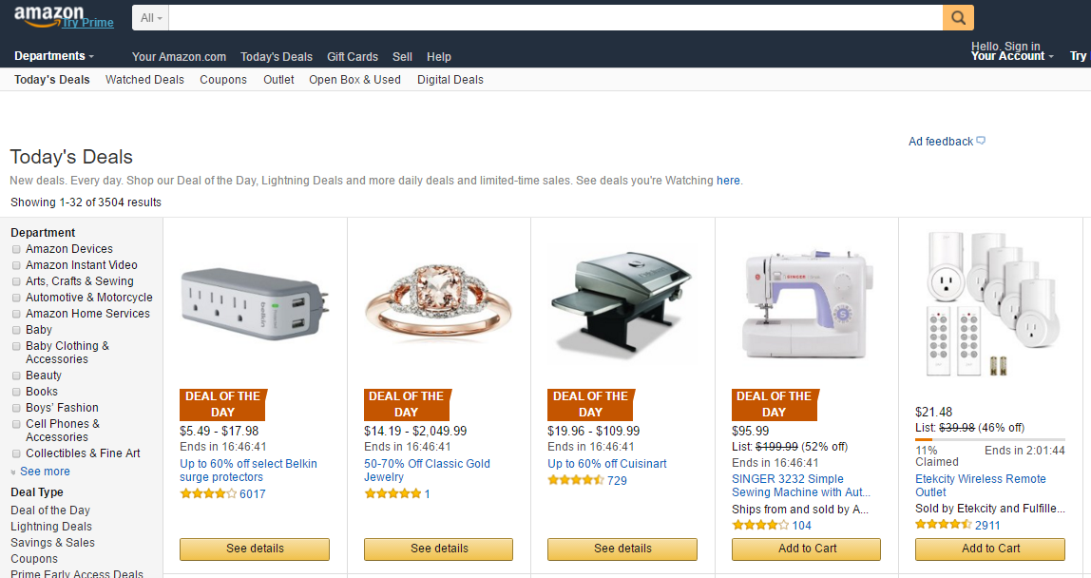
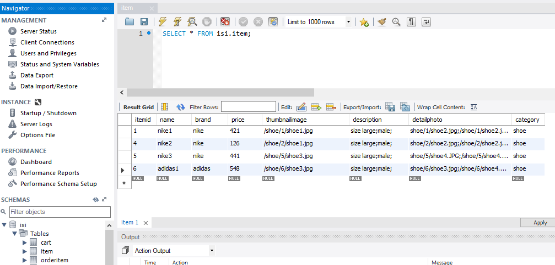
Conclusion and Further Work Conclusion
The project began with an investigation of the current market analysis, examining the mainstream competitors and their advantages. It helped us determine our major products to sell, as well as assisted us to develop better interface and user-friendly interactions.
Our development strictly follows the requirement list, among all these 42 requirements, we accomplished 40 of them. All the compulsory requirements are carefully carried out and checked.
The data of products and business transactions are stored in MySQL database, the whole software system contains 8 tables, user, cart, item, orderitem, orders, rating, review and notification. They are properly linked to each other, in order to support the account management and execution of business transactions.

Slide 38





Conclusion and Further Work Further Work
In the future, we want to ingest more functions through evaluating other e-business website, like Taobao and JD. More flexible category management is the primary goal we want to improve, cause to provide users with better and more convenient user experience is what we have been insisted on.
Concerning about the payment part, domestic widely-used payment methods will be fully supported in ISI store, such as E-bank, UnionPay, and Alipay. Simultaneously, world-renowned payment, such as Paypal will also be available. In order to embed these online payment systems, one of the most crucial pre-requisites is security, some modules, especially account, order, and product management must be reinforced.
Last but not least, we also plan to optimize each module and database for the sake of better robustness and shorter interaction responses in practical application.

Slide 39
References
[1] E-commerce, (n.d.). In Wikipedia. Retrieved March 3, 2015,
From http://en.wikipedia.org/wiki/E-commerce, 2015.
[2] CHINA RETAIL Shopping malls in China - China’s commercial property hot spot as consumer preferences shift. Fung Business Intelligence Centre, October 2014.
[3] Introduction (c#)
From https://msdn.microsoft.com/en-us/library/aa645597(v=vs.71).aspx ,2016
[4] HTML5
From https://en.wikipedia.org/wiki/HTML5
[5] .NET Development
From https://msdn.microsoft.com/en-us/library/ff361664(v=vs.110).aspx
[6] MySQL Introduction
From http://www.tutorialspoint.com/mysql/mysql-introduction.htm
[7] MySQL - Getting started
From http://asp.net-tutorials.com/mysql/getting-started/

Slide 40
Job Distribution
Function requirement A & Z1: Jack
Function requirement B & F1 & F2 & Z2: Tim
Function requirement C & F3 & Z3: Douglas
Function requirement D & F4 & F5 & F6 & Z4: Rancho
Function requirement E & F7 & Z5: Price

Slide 41
Job Distribution
ER diagram: Rancho & Price
User case: Douglas
Architecture design: Rancho
Activities diagram: Jack
State diagram: Tim

Slide 42
Job Distribution
Research study: Price
Report writing: Douglas & Tim
Project coordination: Douglas

Slide 43
Thank you!

